Slide 1
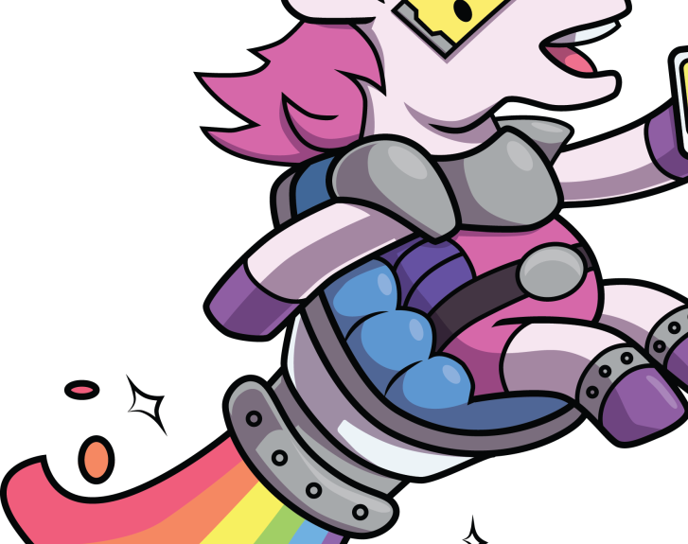
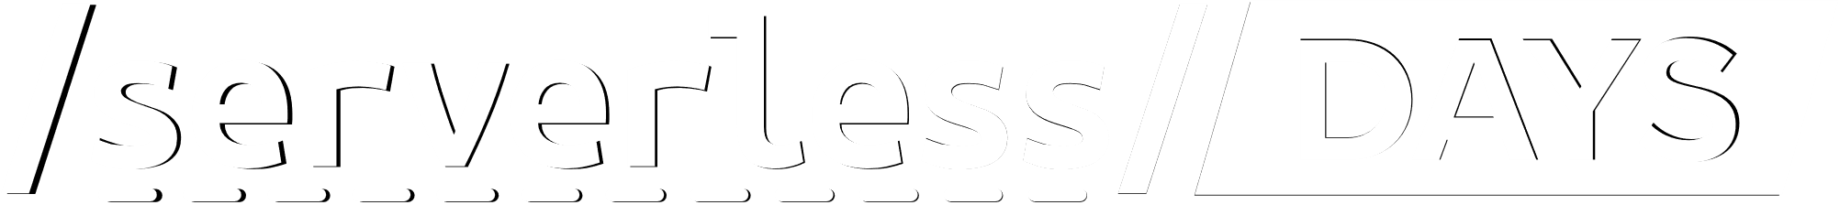
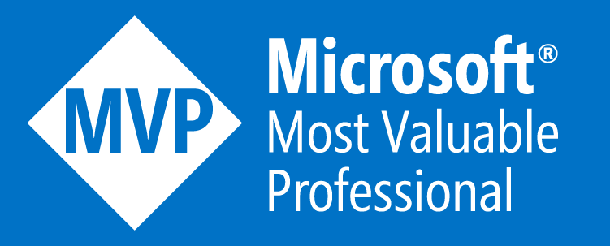
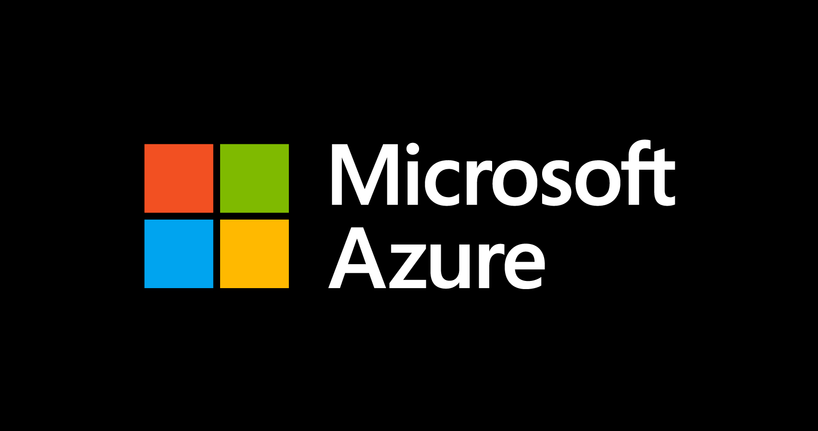


Azure Durable Functions: Yes, PowerShell Can Fan Out and In Too
ANZ 2020
Josh King
 @WindosNZ  ToastIT.dev
Thanks to our sponsors

Slide 2

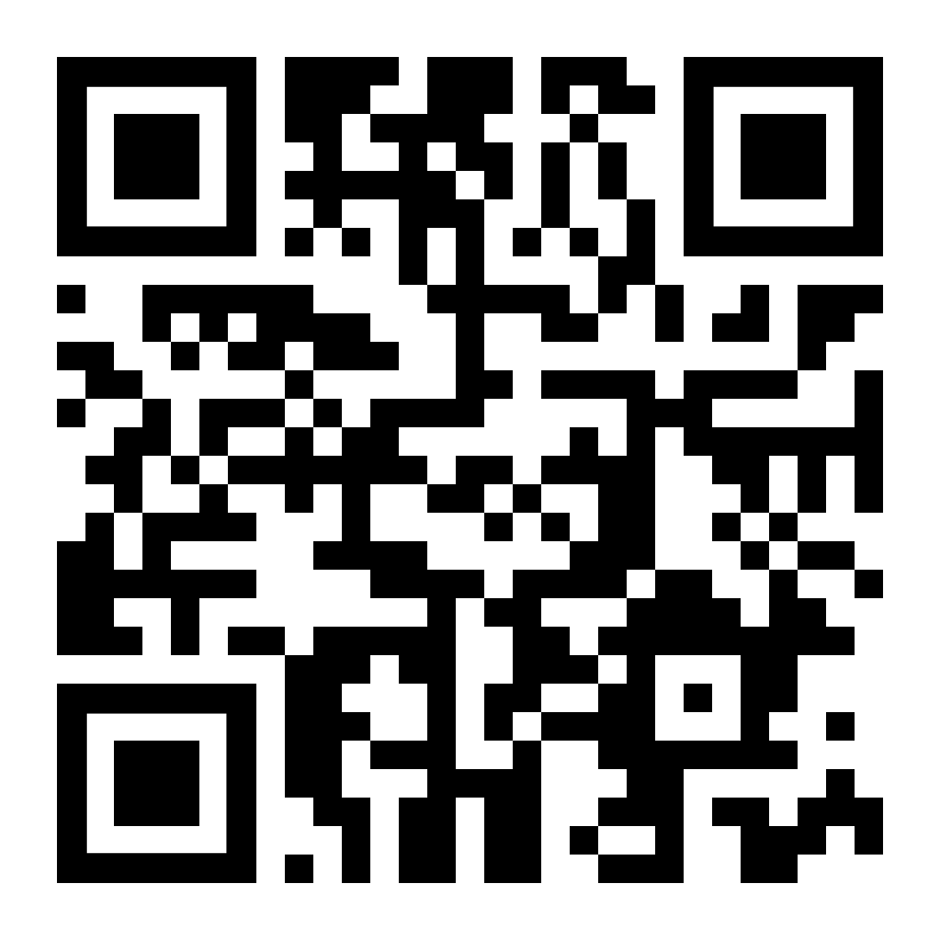

What are Azure Functions?
“allows you to run small pieces of code without worrying about application infrastructure… triggered by a specific type of event”
toast.click/AzFuncIntro
@WindosNZ

Slide 3
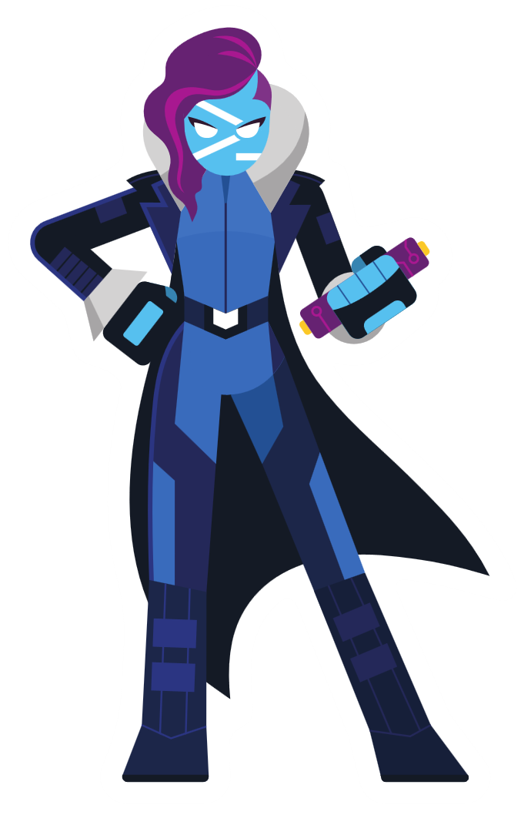
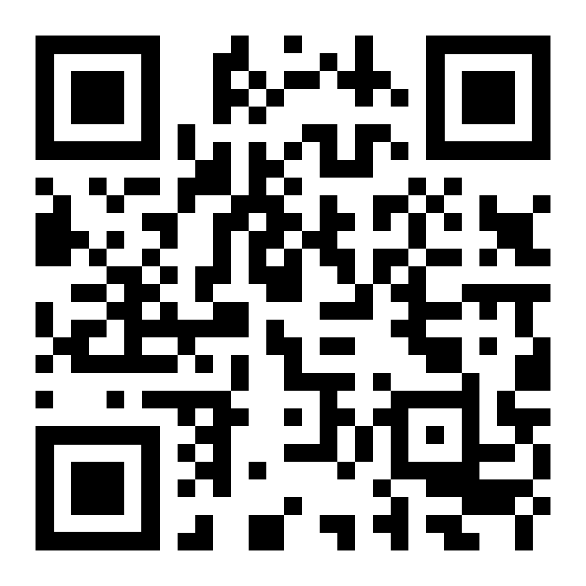
We know… it’s Serverless Days
Supported Languages:
C#
JavaScript
F#
Java
Python
TypeScript
PowerShell
toast.click/AzFuncLanguages
@WindosNZ

Slide 4
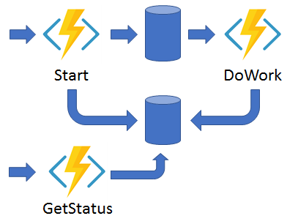
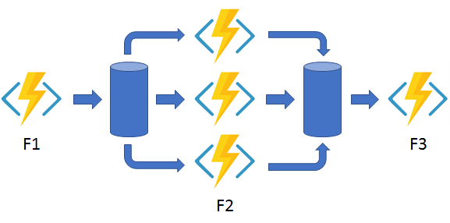
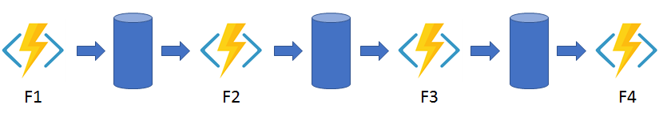
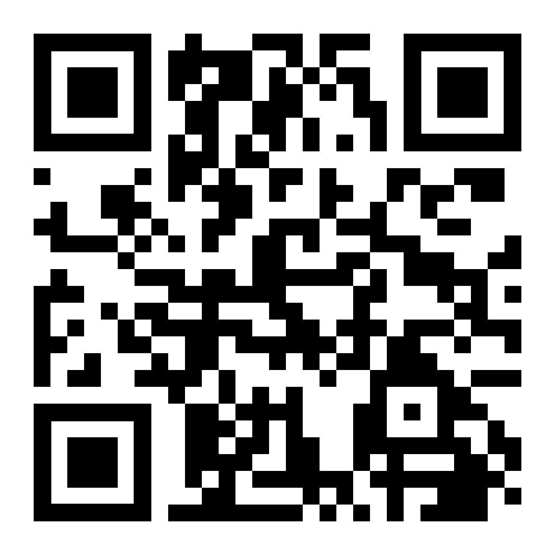
How Are Durable Functions Different?
toast.click/AzFuncDurable
@WindosNZ

Slide 5

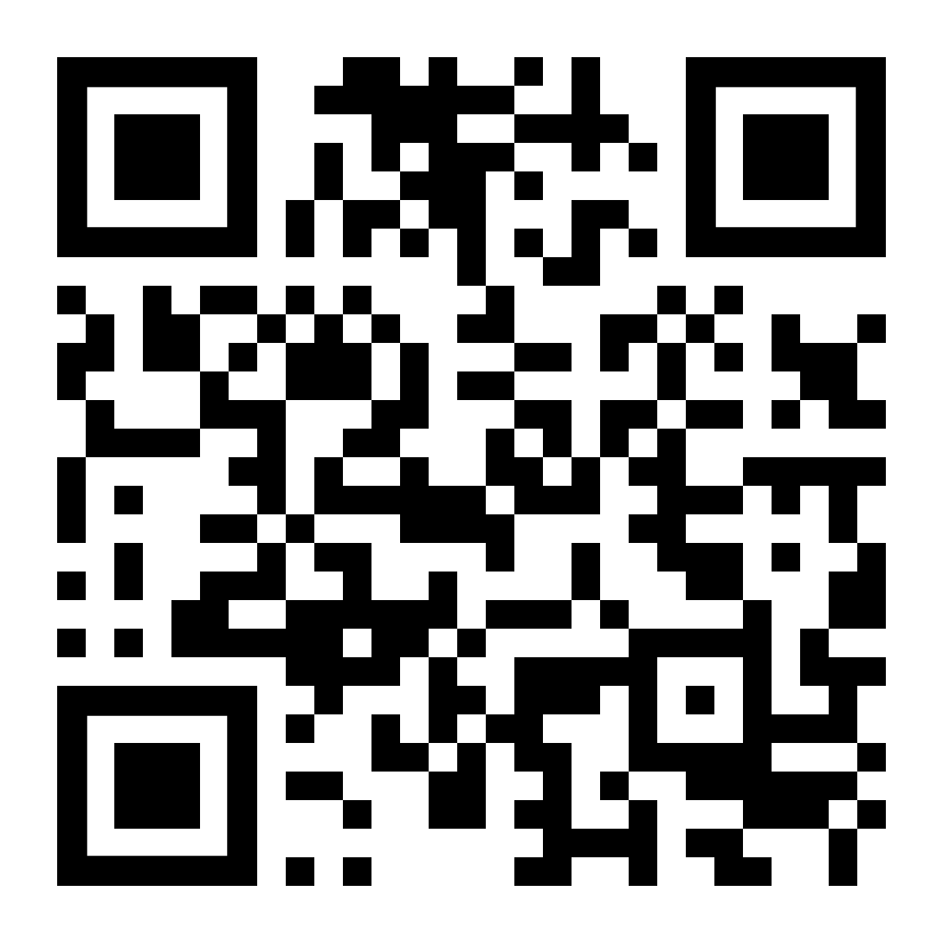
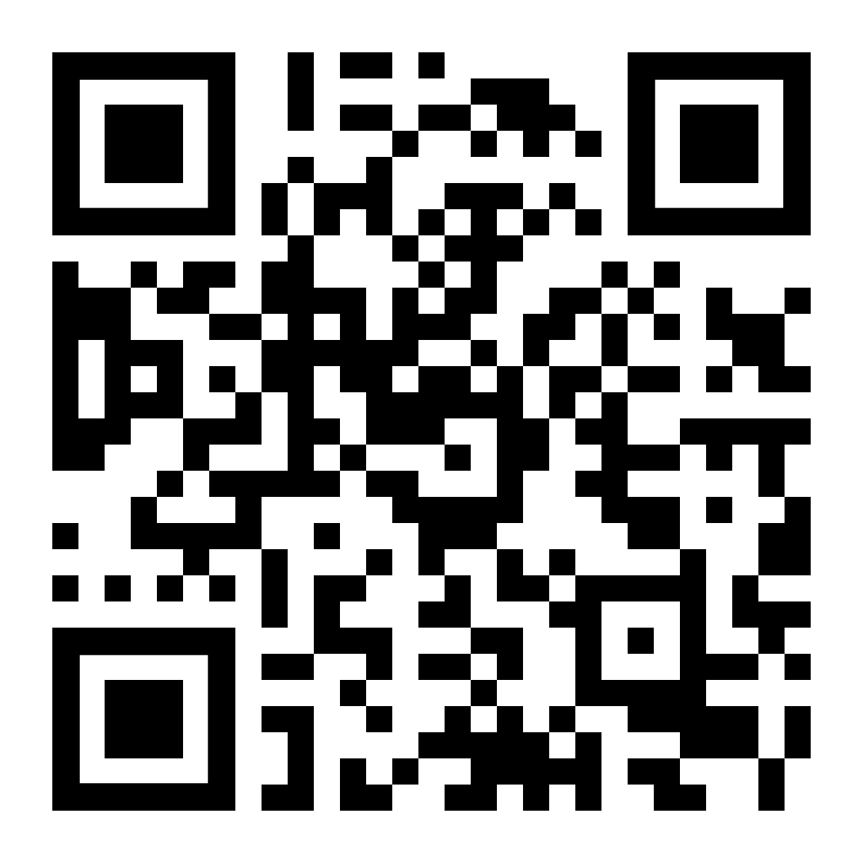
Laying the Groundwork
Azure Account (Sign up for a free trial!)
Visual Studio Code
Azure Functions VS Code extension
Latest version of the Azure Functions Core Tools
Use Chocolatey:
choco install azure-functions-core-tools-3
toast.click/AzFuncPrereq
toast.click/AzTrial
@WindosNZ

Slide 6
Demo
@WindosNZ

Slide 7
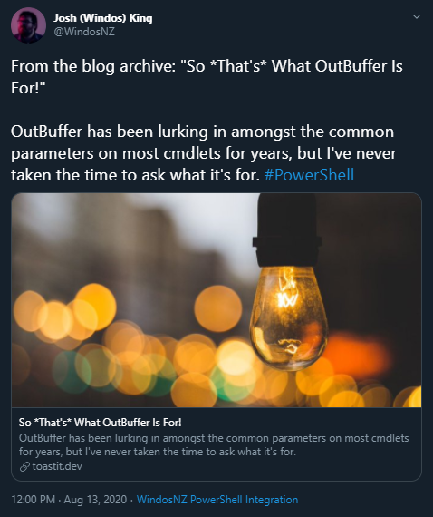

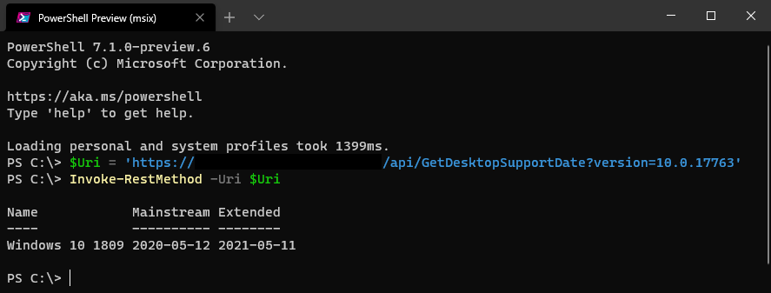
But, Why?
@WindosNZ

Slide 8

What Now?
Try for free: https://aka.ms/TryAzureFunctions
Learn for free: https://aka.ms/LearnAzureFunctions
Dev Community Newsletter: https://aka.ms/DevNewsletterJoin
@WindosNZ

Slide 9
Thank You!
toast.click/Talks
Swag: aka.ms/AzureServerlessSwag
(Thanks Microsoft!)
@WindosNZ

